Slide 1


Halloween
HOLIDAYS AND FESTIVALS

Slide 2
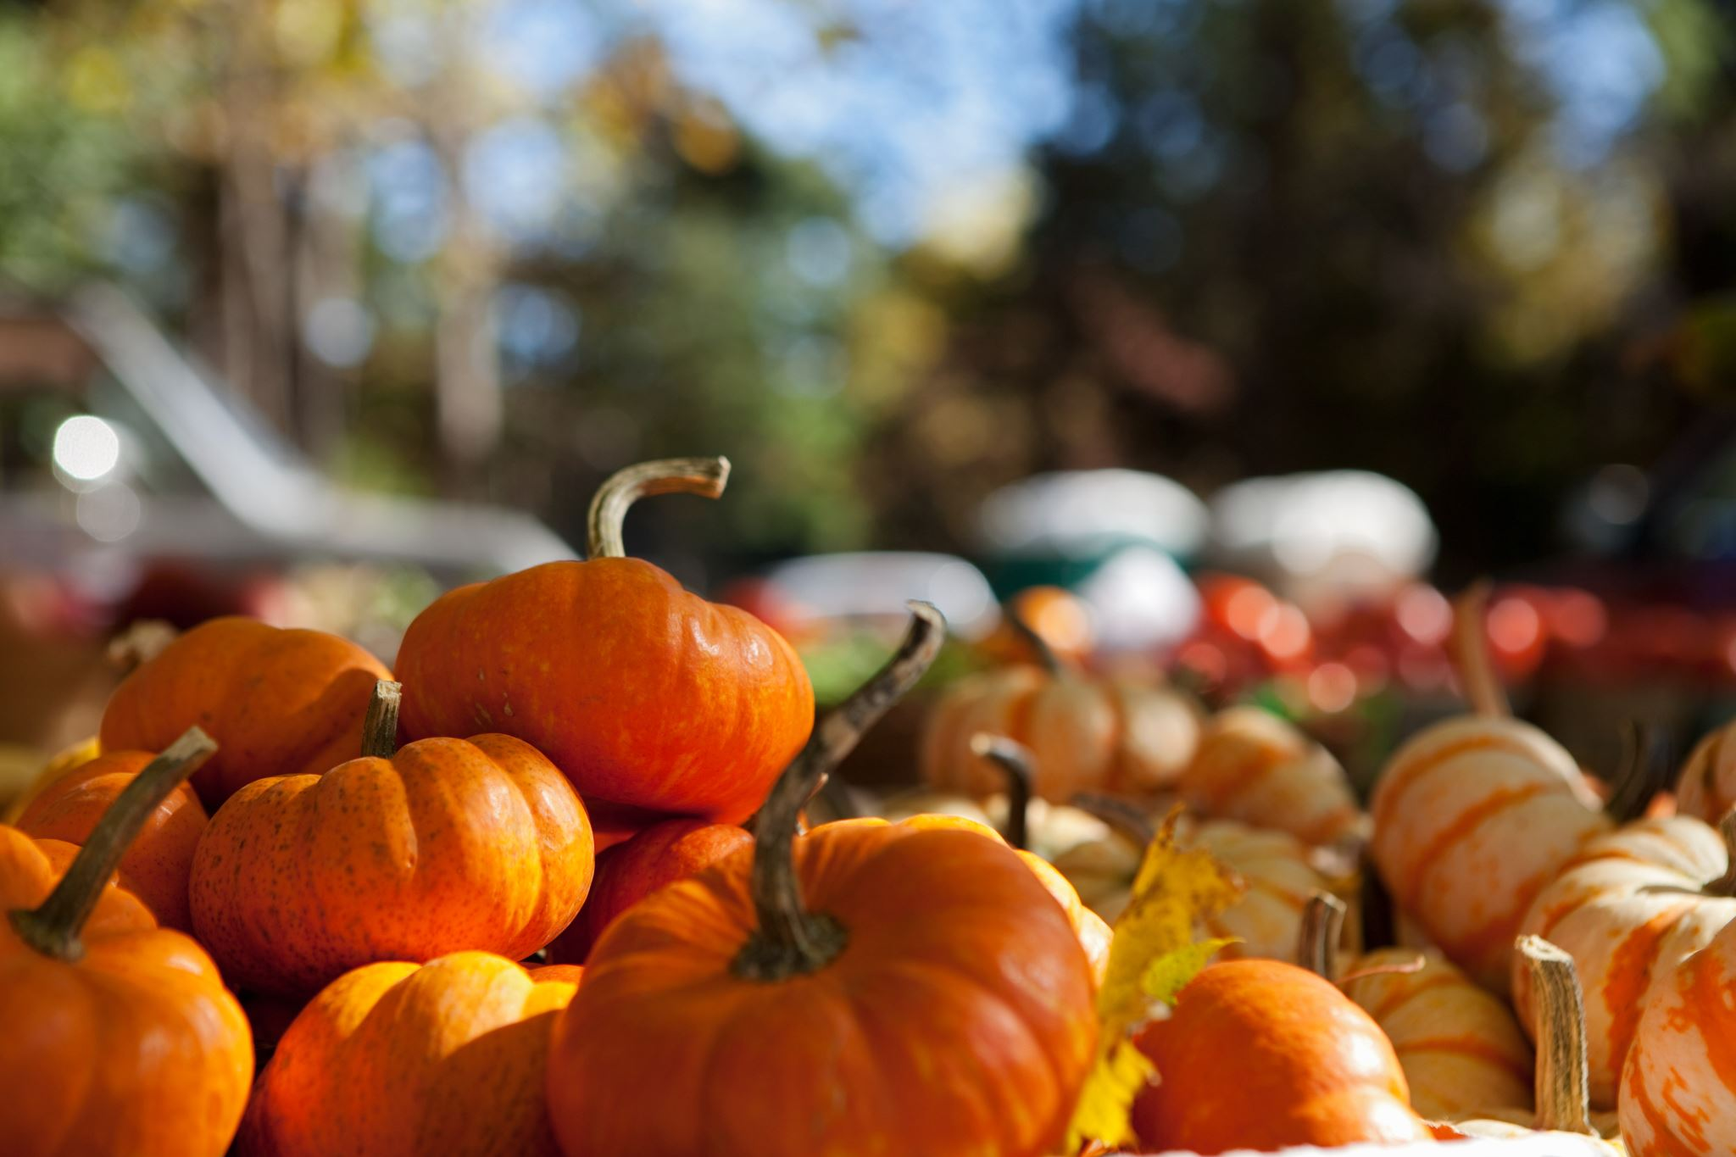
What do you know about Halloween?
What kind of holiday is it?
Why do we celebrate Halloween on October 31st?
Write down the words and expressions which you associate with this fun holiday.
Divide into 4 teams. Do some research on Halloween and the tradition behind it.

Slide 3
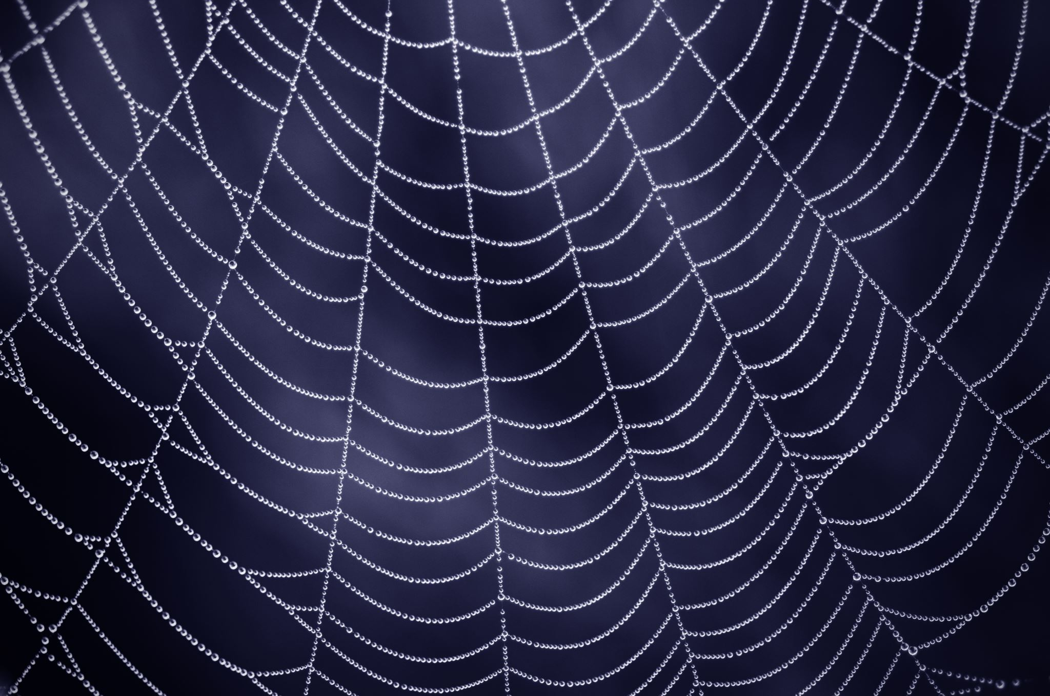
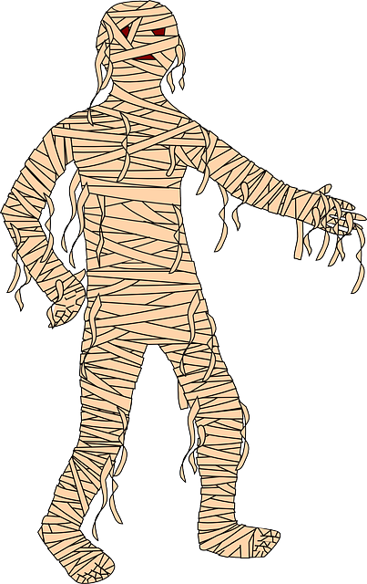
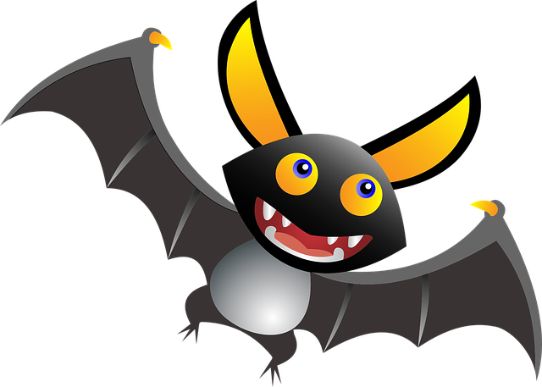
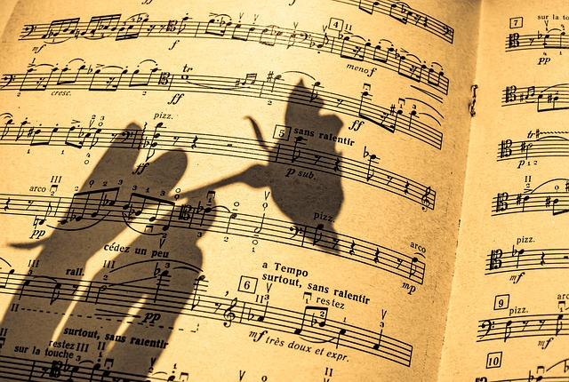
Solve the spooky riddles.
Each morning I appear to lie at your feet. All day long I will follow you, no matter how fast you run. Yet, I nearly perish in the midday sun.
A shadow
I sleep upside down and I fly through the night. I live in dark places and I don’t have good eyesight. What am I?
A bat
I am present, but also past. I am wrapped, but not a gift. I am named after a parent, but have no children.
A mummy.

Slide 4
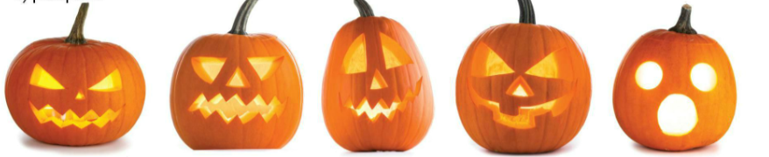
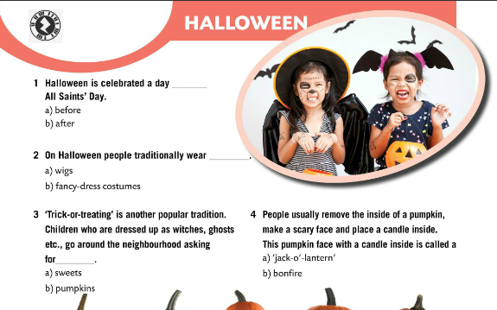
Circle the correct answer.
Check.
Play a game! ☺
https://wordwall.net/play/856/324/669

Slide 5
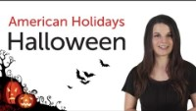
In this video, you'll learn all about Halloween in the United States and how it's celebrated, from food to decorations, while building your English vocabulary.
What do you think of Halloween celebrations?
What tradition do you find most interesting? Why?

Slide 6
Happy Halloween!
I hope your Halloween is all treats and no tricks.
May your jack-o’-lantern shine bright! ☺

